Slide 1
Finch Robots I
JMU DIGITAL 2018

Slide 2
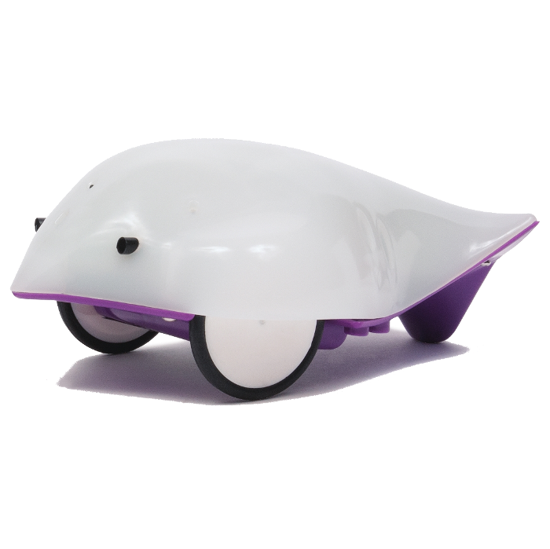
What is a Finch Robot?

Slide 3
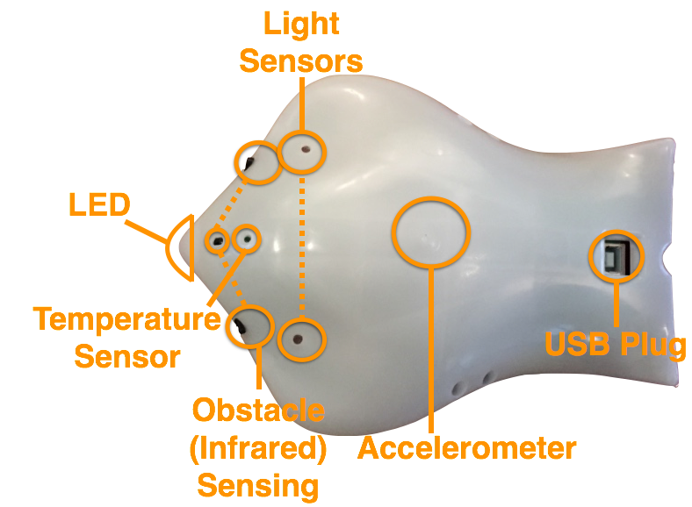
The Parts of a Finch Robot

Slide 4
Programming with Python
Statements, expressions & variables
“Making” a Finch
Using functions to play with the Finch
Notes:
We will be using statements, expressions & variables to control the robot and make it do whatever you want
We will use the Python programming language to make our Finches and tell them what to do
There are a ton of super cool functions we can use to make the Finch move, light up, and even sing

Slide 5
Let’s get our Finches Running!

Slide 6
Make your Finch
Give your Finch a name - be as creative and fun as you want!
Ex. hermione = finch.Finch()

Slide 7
Turn your lights on
Light up the beak of you Finch using the led function, it’ll look something like this:
hermione.led(#, #, #)
The numbers correspond to the amount of red, green, and blue LEDs lighting up the beak of the Finch. You can play around and make whatever color you want!

Slide 8
Make some fireworks!
… or a rainbow! Use time’s sleep function to make you Finch’s beak a variety of colors
time.sleep(# of seconds)

Slide 9
Let the Finches Fly! (well, sorta)
Use the wheels function to see your Finches take flight!
hermione.wheels(left, right)

Slide 10
Make them dance & sing!
Use the buzzer function and all of the skills you’ve learned so far to have a Finch dance party!
hermione.buzzer(frequency, length)

Slide 11
What else can you do with the Finches?
Notes:
Can you make the Finch make a shape by using the wheels function?

