Slide 1
Finch Robots II
JMU DIGITAL 2018

Slide 2
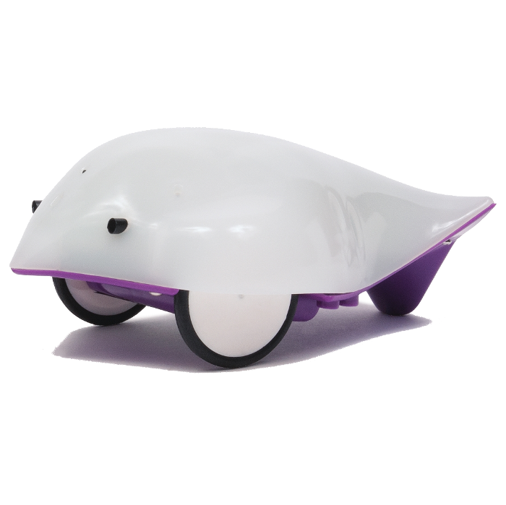
What is a Finch Robot?

Slide 3
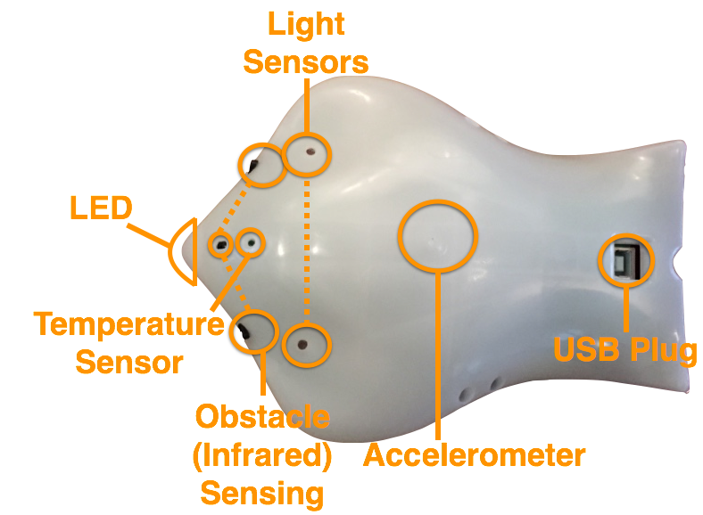
The Parts of a Finch Robot

Slide 4
Crash Course in Python Programming

Slide 5
Statements, Expressions & Variables
Statement: an instruction that the Python interpreter can execute.
Expression: combination of values, variables, operators, & calls to functions. The Python interpreter evaluates these expressions.
Variable: a name that refers to a value.
Notes:
Create a finch object using a statement and variable assignment, use some of the finch functions to move the robot, mess with its lights, etc.

Slide 6
Conditionals
if (some condition that’s true or false):
Do something
elif (some other condition):
Do something different
else:
Do this other thing
Notes:
Use the obstacle sensor or light sensor to make the finch do something, maybe change the color of the lights?

Slide 7
Loops
while (Some condition that is true):
Do stuff until the condition is false
Notes:
You can use conditionals and loops to make the finch do something for an indefinite period of time, like run the wheels until an obstacle is encountered

Slide 8
Defining Functions
Function: block of organized, reusable code used to perform a single, related action
Parameters: any input you need to give your function
def function_name(parameters):
Function body
Notes:
You can make the Finch go in the shape of a square, but that takes a lot of repetitive code, can you put it in a function that makes it simpler?

Slide 9
Random
You can use Random to generate a pseudo-random number
Syntax:
At the beginning, put import random
rand_generator = random.Random()
num = rand_generator.random() // Generates a random number between 0 and 1
Notes:
You can mess around with Random and conditionals to randomly change the color of the Finch’s beak

Slide 10
Can you teach the Finch how to navigate a maze?

