Slide 1
Intro to Web Design
The basics of coding in HTML and CSS

Slide 2
What is CIS
CIS - stands for Computer Information Systems
Business major
Learn all about business
Learn coding and Technical skills
Java, Python, HTML, CSS, Database Design, System Design

Slide 3
What is HTML and CSS?
HTML stands for Hyper Text markup Language
CSS stands for Cascading Style Sheets
These are languages used for Web Development

Slide 4
Tips: Ctrl commands
Ctrl + C Copy
Ctrl + V Paste
Ctrl + X Cut
Ctrl + Z Undo

Slide 5
Getting Started with HTML
Start with: <!DOCTYPE html>
DOCTYPE is needed to enable standards mode for documents written using the HTML syntax
To write comments:
<!-- -->
Then you put everything inside HTML tags
<html> </html>
You put your title and your style in the Head tags
<head> </head>
You put your content in the Body tags
<body> </body>

Slide 6
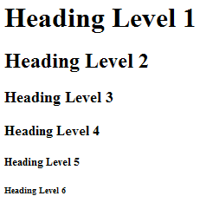
How to write in HTML
HTML uses tags to format text
Paragraph <p> </p>
Heading <h1> </h1> <h2> </h2> …. <h6></h6>
Line break <br/>
Section <section> </section>
Images <img scr=”color.jpg”/>
<h1>
<h2>
<h3>
<h4>
<h5>
<h6>

Slide 7
Link to different pages
<a href="blue.html">Blue</a>

Slide 8
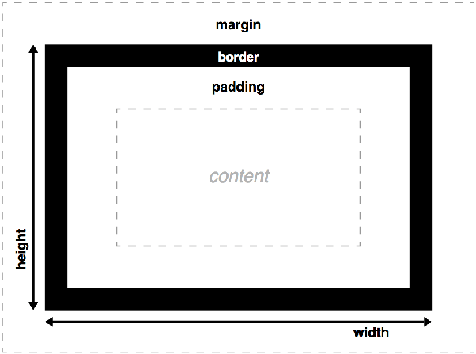
Formatting
Margins: very outside
Border: box around content
Padding: barrier between border and content

Slide 9
To help you in the future
Hex colors: https://www.computerhope.com/htmcolor.htm
W3schools.com
Codepen.com

